Slide 1
JOB Database Management System
IST 659
Surjit Singh
288094898

Slide 2
Project goals:
Major functions of Courier Database system are -
To design a database for National University of Technology for managing career building events and jobs for their students.
Three important aspects in this system are – Job posting and applications managements, posting of events and enrolment management, Managing information for Faculty, Employers and Students
To increase automation and reduce manual effort by giving features like viewing jobs and events, applying for jobs and events, adding and updating information of all end users, accepting rejecting applications.

Slide 3
Project goals :
Important points and features that this design incorporates are as mentioned below:
Faculty, Employers and Students can login in system using username and password.
Students can view and apply for jobs and events.
Students can also view and edit their own information
Employers can post job to the system and also view applications only for jobs that they posted.
Employers can accept and reject the application using application ID.
Faculty can search and add students, faculty, employers and events.
Faculty can also see reports on their page which are requested by user to incorporate in the system.

Slide 4
Business rules:
An employer can post multiple jobs.
A student can apply to multiple jobs
A faculty can post multiple events
An event can be enrolled by multiple students
A student can attend multiple events
Job status should be updated in applied jobs table
Employer can be of type Private/Government
Student and Faculty can have status Active/Inactive

Slide 5
Project goals:
Major Data Questions –
Check application status for all students who applied for job
Check total number of students enrolled per course
Check total number of students placed per course
View detailed information of students and jobs who applied for that job when a particular employer is logged in

Slide 6
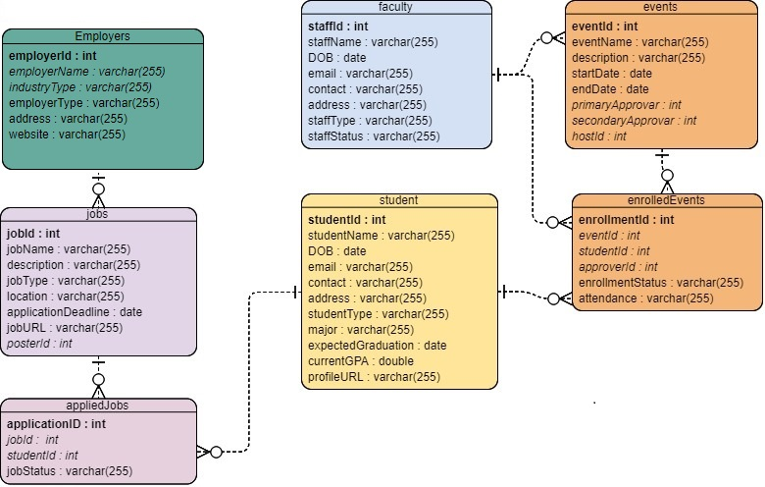
ERD :

Slide 7
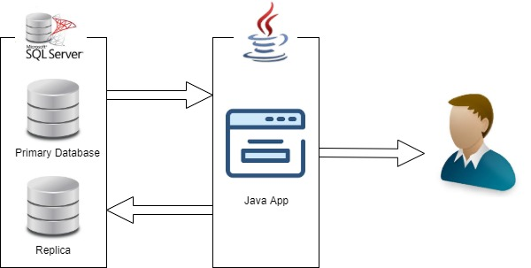
Application Diagram

Slide 8
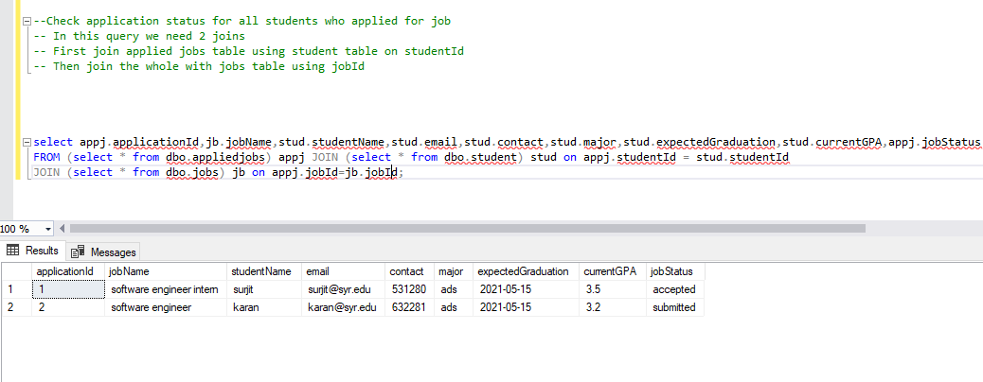
Major Data Question1 : Check application status for all students who applied for job

Slide 9
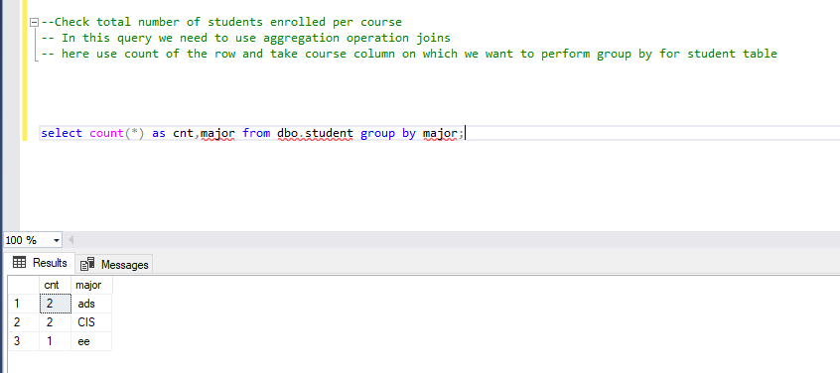
Major Data Question 2: Check total number of students enrolled per course

Slide 10
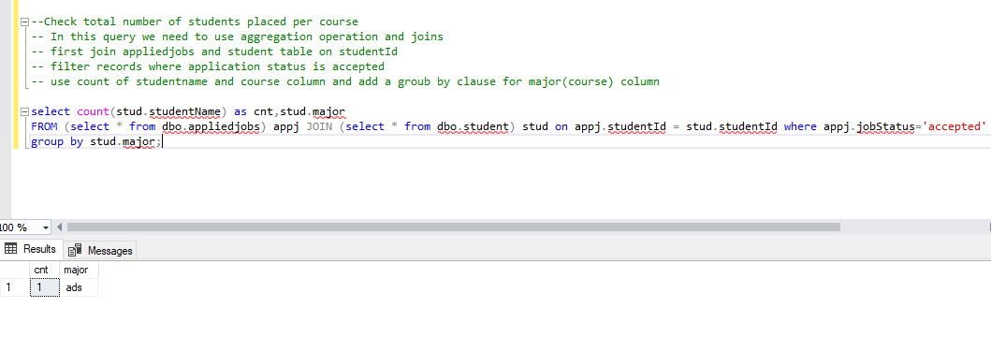
Major Data Question 3: Check total number of students placed per course

Slide 11
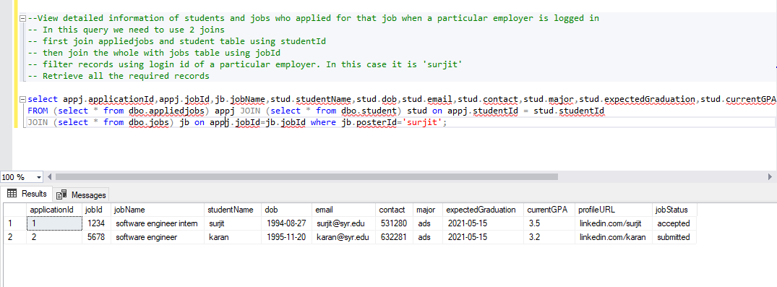
Major Data Question 4: View detailed information of students and jobs who applied for that job when a particular employer is logged in

Slide 12
Application DEMO
Please use below link or the video uploaded on blackboard for application demo.
https://drive.google.com/open?id=1HvCitauKiuCVpaYB9cCIl4BDJSNYgSNO

Slide 13
THANK YOU

